Slide 1

Blog application
Prepared by:
Daksh Bareja(20012022001)
Vinod Bhagora(19012021005)

Slide 2
Table of contain
1 INTRODUCTION
1.1 Purpose
1.2 Overview
1.3 Objective
1.4 Tools and Technology

Slide 3
Table of contain
2. FEASIBILITY STUDY
2.1 PROBLEM STATEMENT
2.2 EXISTING SYSTEM
2.3 DRAWBACKS OF EXISTING SYSTEM
2.4 BENEFITS OF PROJECT
2.5 HARDWARE AND SOFTWARE REQUIREMENT STUDY
3.SYSTEM REQUIRMENTS STUDY
3.1 Functional Requirement
3.2 Non-Functional Requirement

Slide 4
Table of contain
4.SYSTEM DESIGN
4.1 Use case
4.2 Class Diagram
4.3 Activity Diagram
4.4 Sequence Diagram
4.5 State Diagram
4.6 DFD Diagram
4.7 ER Diagram
5. REFERENCE

Slide 5
INTRODUCTION
Definition
A DevOps community Blogging platform is a type of website or part of a website, which is the publication of regular articles over time in some area of personal or professional interest. Blogs are usually maintained by an individual with regular entries of commentary, descriptions of events. Blog can also be used as a verb, meaning to maintain or add content to a blog

Slide 6
INTRODUCTION
Overview
The main aim of this application is to provide a hassle-free accessing of the posted blogs, entries, topics etc. It also used for posting the blogs, editing the blogs, deleting the posted blogs etc. It is also used for viewing and posting the others one’s blogs/posts.

Slide 7
INTRODUCTION
Purpose
By my analysis on website, I was expected that for common people to develop website , they have to face many problems and also they want to share their knowledge, technology, articles, etc. The objective of our Project is to provide all its user with easy access to relevant, and by using provide them Choosing facility to component

Slide 8
INTRODUCTION
Objective
The “DevOps Community Blogging System” has been developed to override the problems prevailing in the practicing manual system. This software is supported to eliminate, and in some cases reduce the hardships faced by this existing system.

Slide 9
FEASIBILITY STUDY
Problem Statement
The old manual system was suffering from a series of drawbacks. Since whole of the system was to be maintained with hands the process of keeping, maintaining and retrieving the information was very tedious and lengthy.

Slide 10
FEASIBILITY STUDY
Existing System
Existing system is a manual system. It requires lots of file work to be done. It is a time consuming system. All user information is maintained manually. Any searching requires so much effort manually.

Slide 11
FEASIBILITY STUDY
Drawback of Existing System
1) Maintaining registers is costly – traditionally documents have been stored in batches and they filed in file cabinets and boxes. A numerical system is assigned specifically a user number assigned to organize the files.
2) Error prone – existing system are error prone, since manual work is required. More time is consumed and errors may propagate due to human mistakes.

Slide 12
FEASIBILITY STUDY
Tools
Visual Studio Code(IDE)
Postman(For API Testing)
Programming Language /script: Javascript
Frontend/UI Design: React
Backend: Express.js and Node.js
Database: Mongodb

Slide 13
FEASIBILITY STUDY
Hardware(User side):
Hardware(Development Side):
Software(User Side):
Minimum | Recommended
RAM:2 GB | 4 GB or more
Internal Storage: 16 GB | 32 GB or More
Minimum | Recommended
RAM: 2 GB | 4 GB or more
Hard Disk: 256 GB | 512 GB or more
Minimum | Recommended
OS: Any OS | OS: Windows 10 or more
Web Browser | Chrome or Firefox latest version

Slide 14
SYSTEM REQUIREMENTS STUDY
Functional Requirements
Admin:-
View Blog:-
Input: -Details of Blog .
Process: - Manage information about blog.
Output: - Data will update.
Delete User:-
Input:- Delete user from application.
Process:- Process data into the database.
Output:-Data will update.
Delete Blog:-
Input: -Delete the blog .
Process: -remove blog from database .
Output: - Data will update.

Slide 15
SYSTEM REQUIREMENTS STUDY
Functional Requirements
Manage Comments:-
Input: - Manage comments .
Process: - Manage companies like update details, delete company, etc.
Output: - Data will update.
View Reports:-
Input: - See reports given by user .
Process: - Select reports from database.
Output: -reports will display.

Slide 16
SYSTEM REQUIREMENTS STUDY
Functional Requirements
User:-
Signup:-
Input: - Name, Password, etc.
Process: - Store data of user into the database.
Output: - User can be the part of the system.
Sign in:-
Input: - username and password.
Process: - Verify data of user into the database.
Output: - User can be able to use the functions of system.
Post Blog:-
Input: - Post title ,description, photos .
Process: - Store post into the database.
Output: - see the blog on page.

Slide 17
SYSTEM REQUIREMENTS STUDY
Functional Requirements
Give Comments:-
Input: - Give review.
Process: - Insert feedbacks on database.
Output: - Blog gets feedback.
Non-Functional Requirements
Availability: - When user clicked on any function then it is available.
Performance: - Information should be update on that time when user enters the entries.
Reliability: - Data transfer from trustable way / secure way and use trustable protocol.
Scalability:-More Number of Users will be able to use system simultaneously.

Slide 18
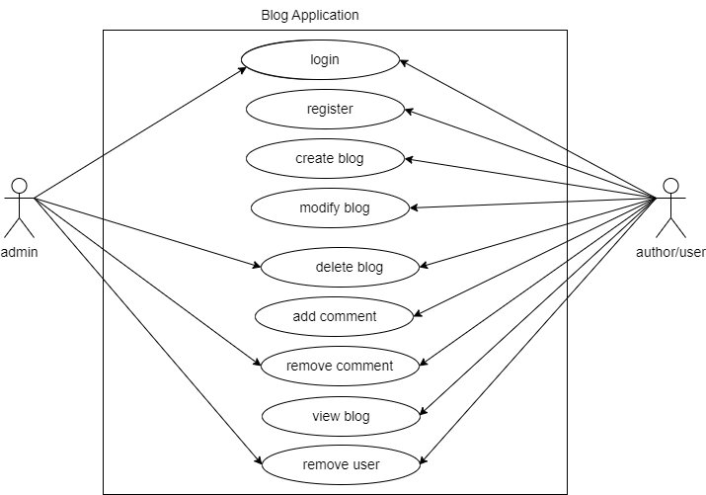
SYSTEM DESIGN
Use case Diagram

Slide 19
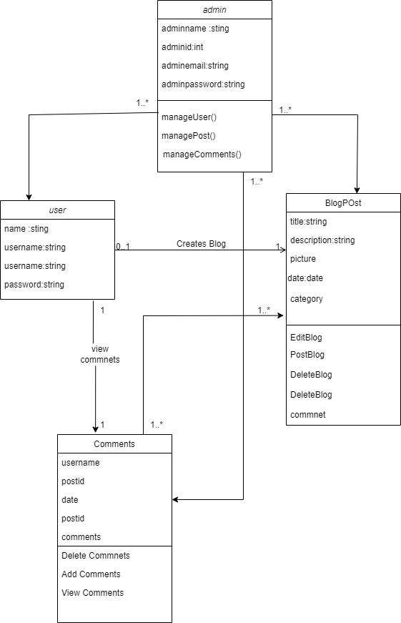
SYSTEM DESIGN
CLASS DIAGRAM

Slide 20
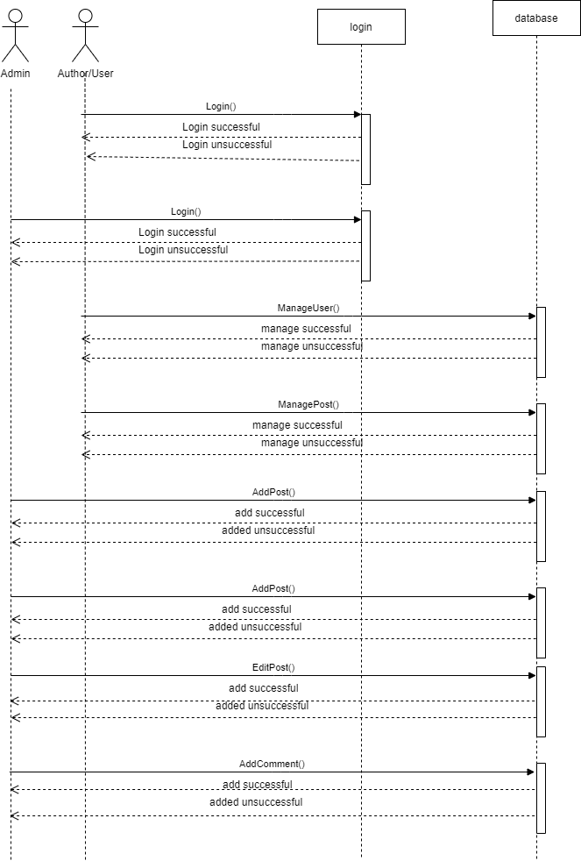
SYSTEM DESIGN
SEQUENCE DIAGRAM

Slide 21
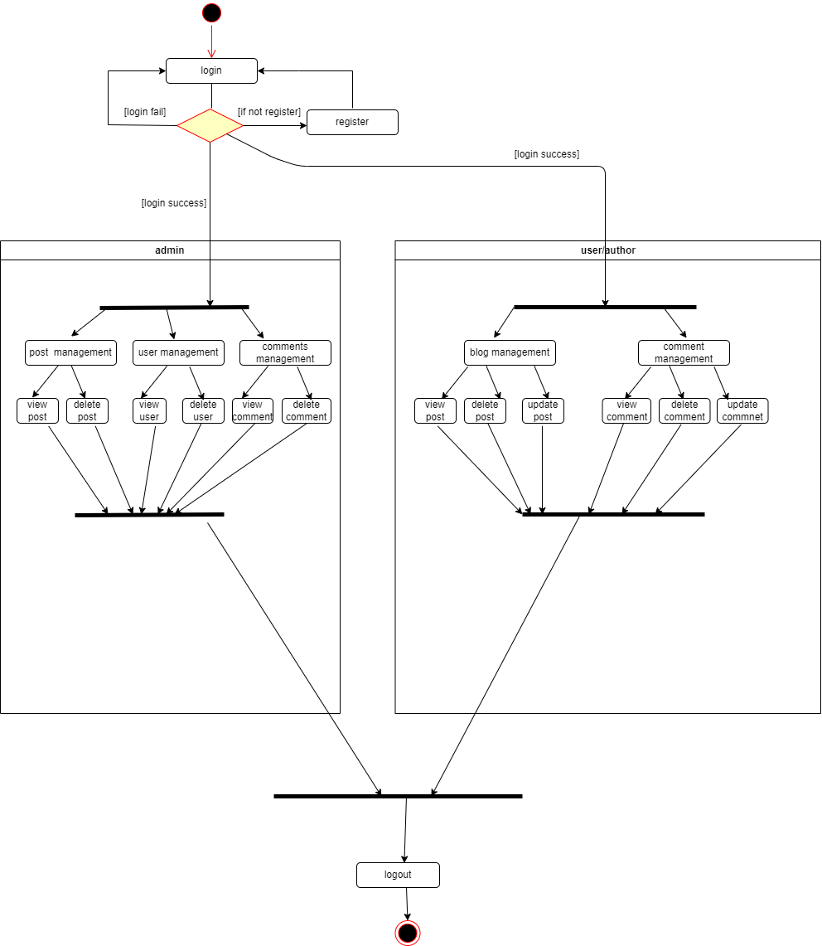
SYSTEM DESIGN
ACTIVITY DIAGRAM

Slide 22
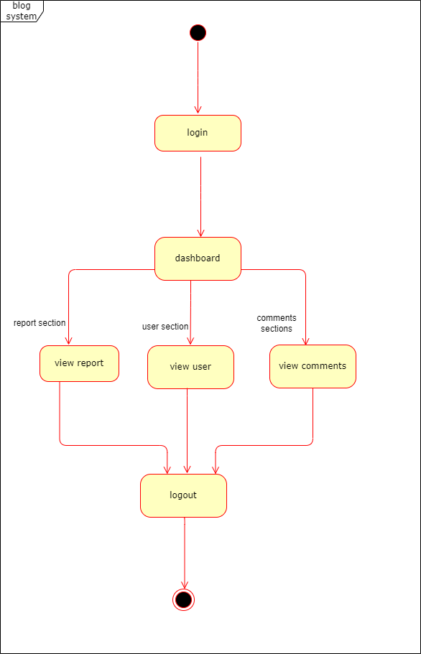
SYSTEM DESIGN
State Diagram[Admin Diagram]

Slide 23
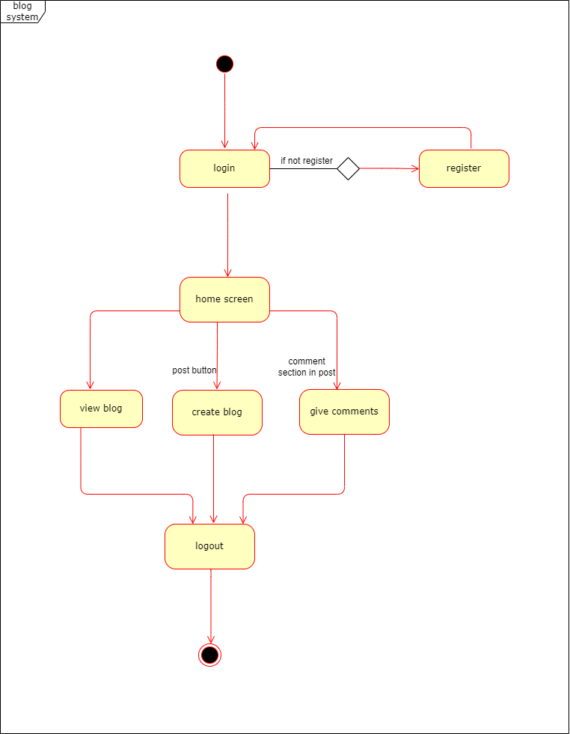
SYSTEM DESIGN
State Diagram [User Diagram]

Slide 24
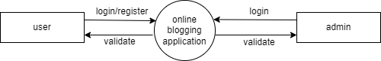
SYSTEM DESIGN
DFD Diagram-level 0

Slide 25
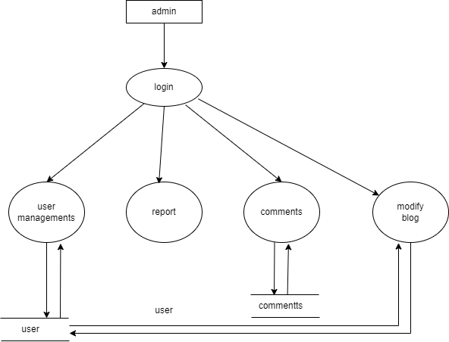
SYSTEM DESIGN
DFD level 1Admin Diagram

Slide 26
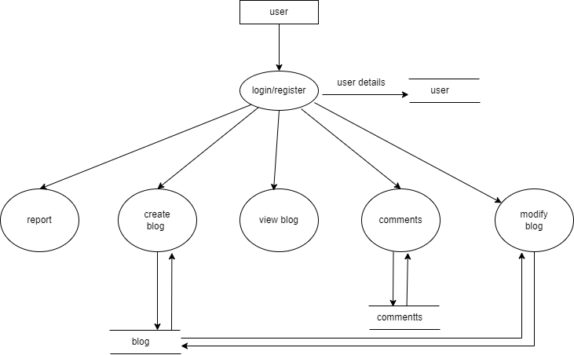
SYSTEM DESIGN
DFD level 1 user Diagram

Slide 27
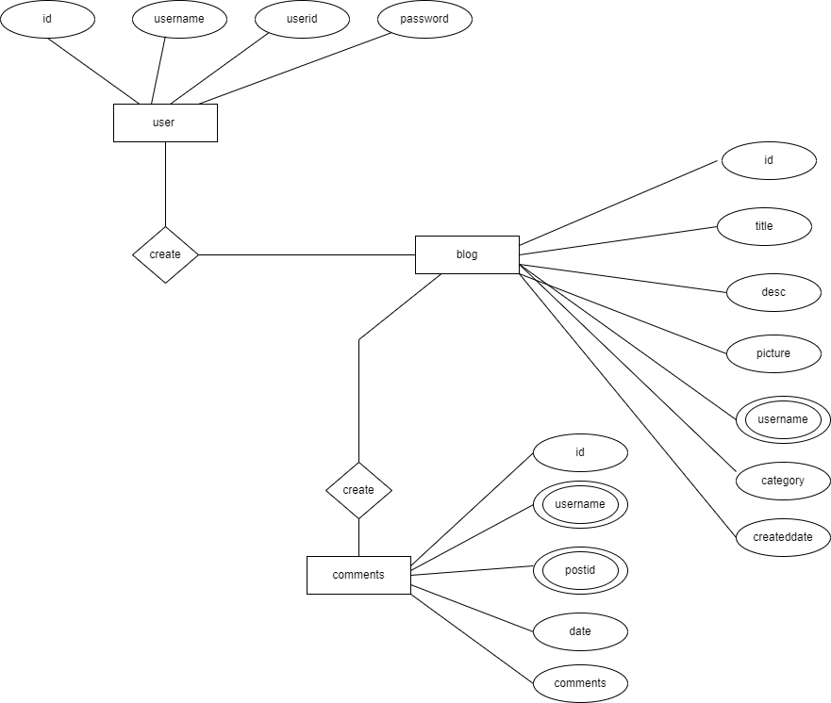
SYSTEM DESIGN
ER Diagram

Slide 28
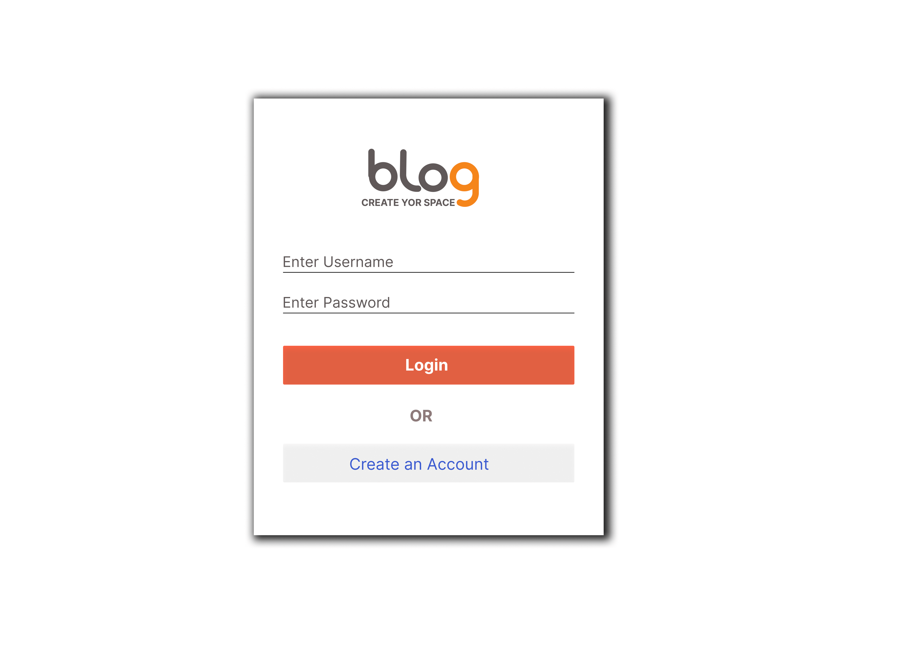
PROTOTYPE
Login:-

Slide 29
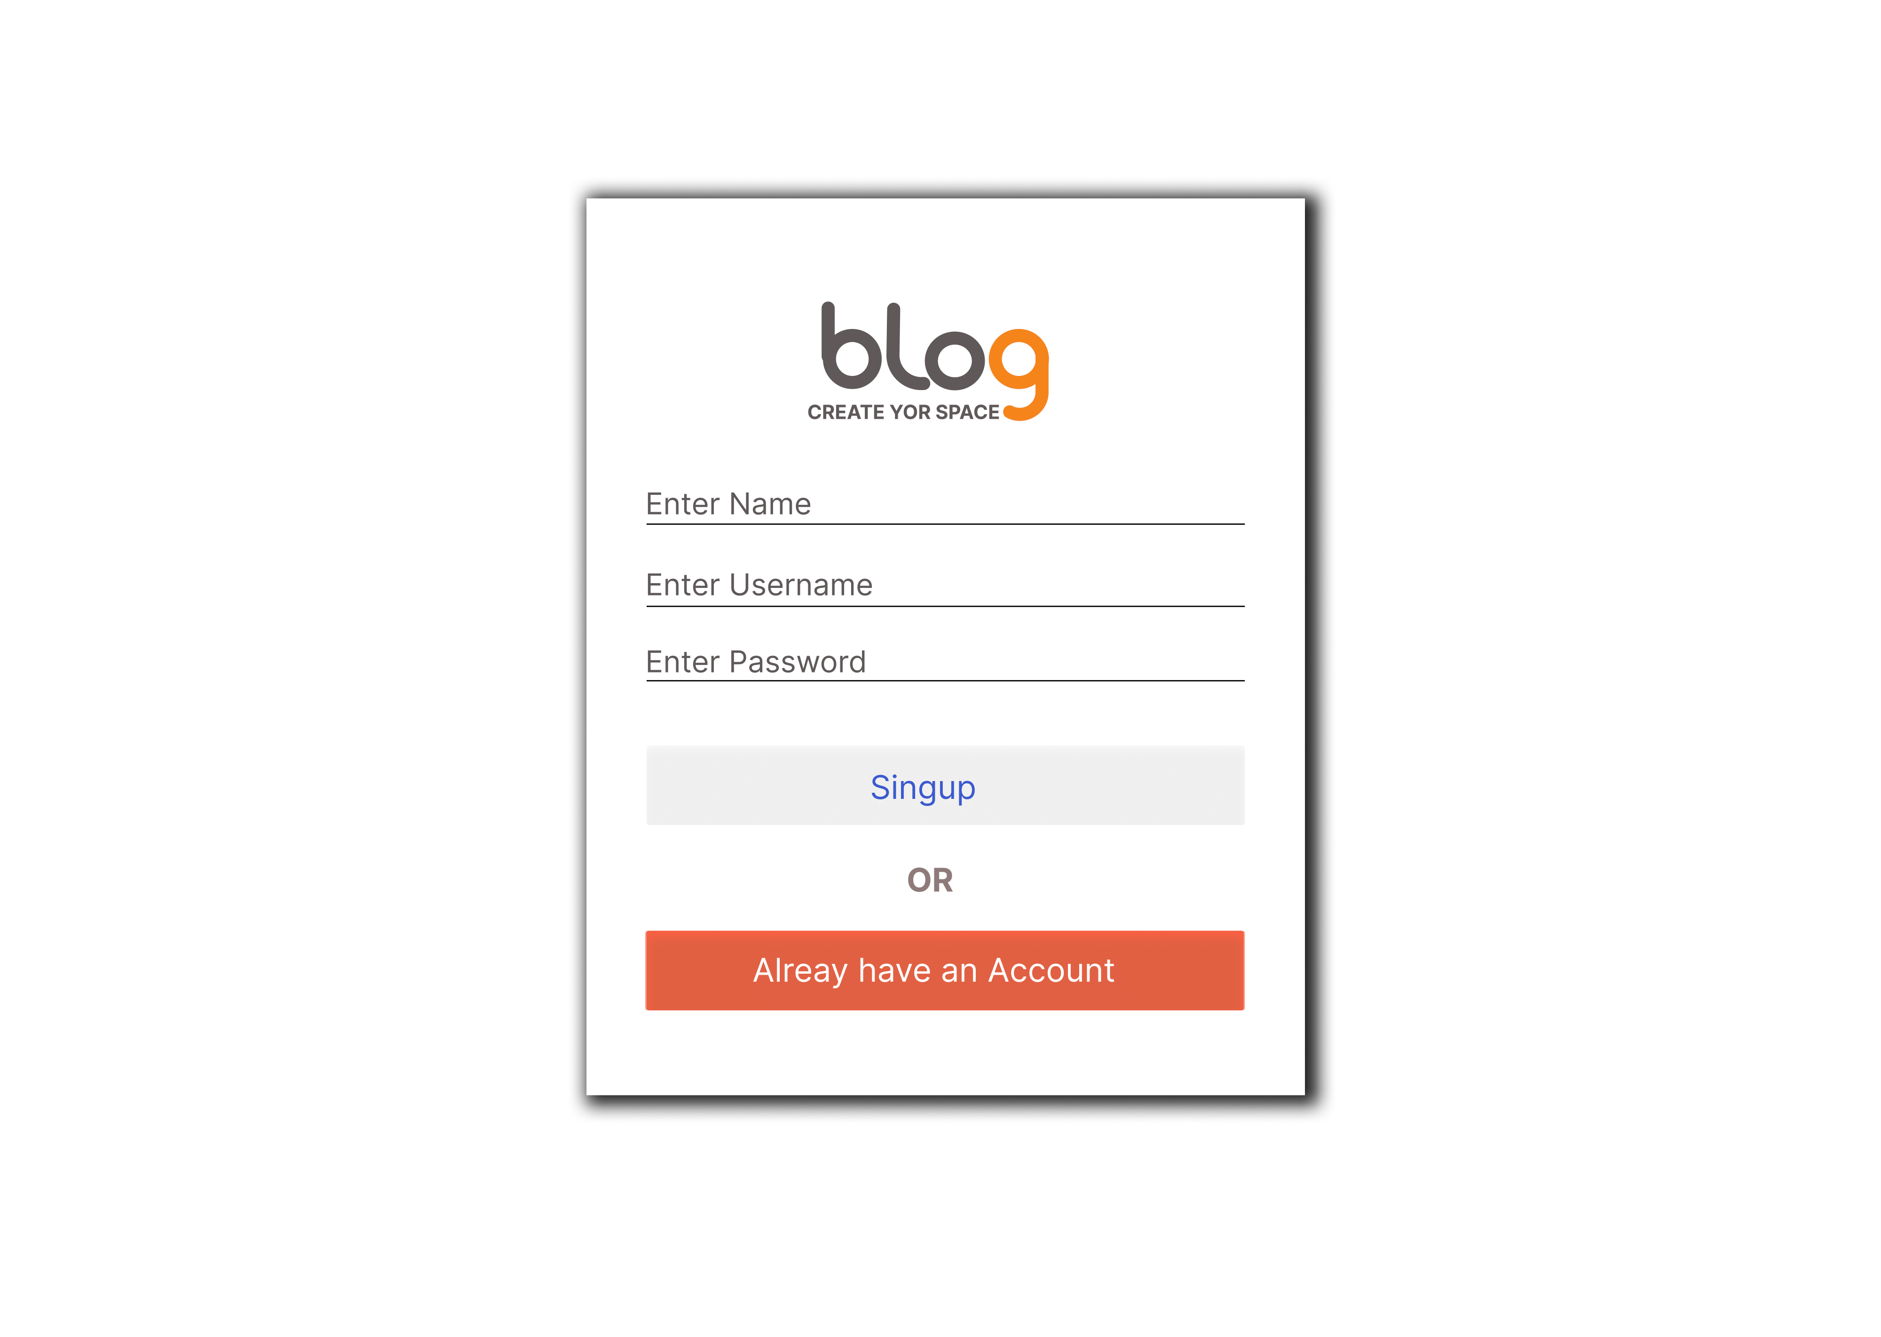
PROTOTYPE
SignUp:-

Slide 30
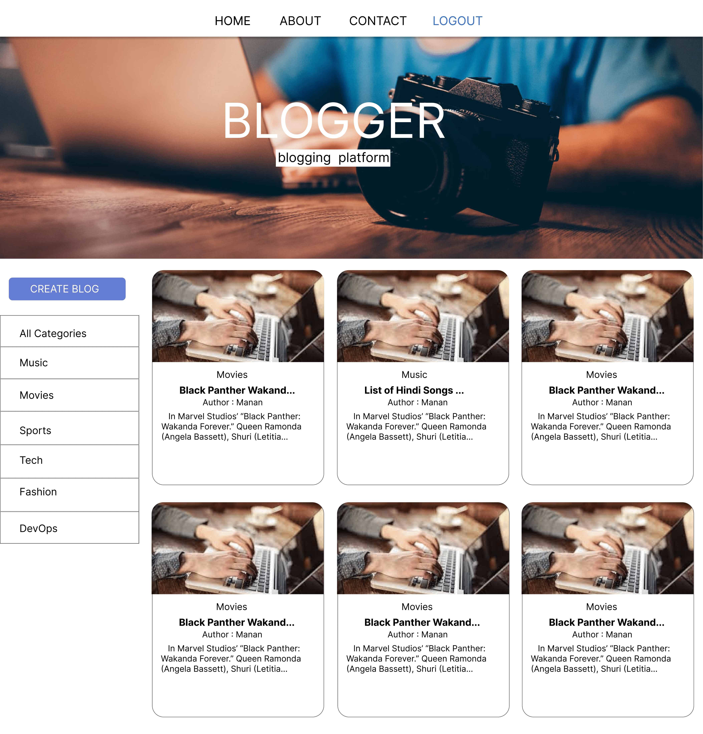
PROTOTYPE
Home Page:-

Slide 31
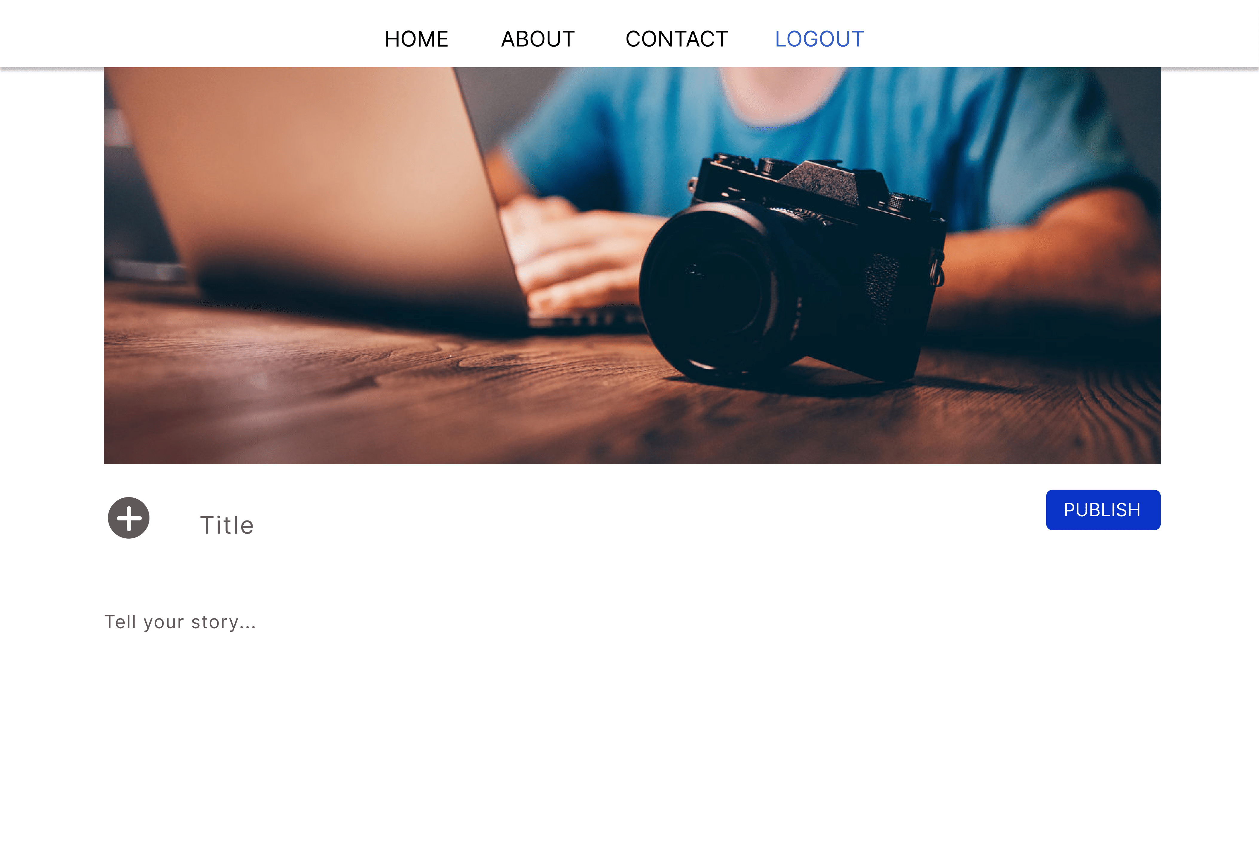
PROTOTYPE
Create Post:-

Slide 32
REFRENCE
(July-2022) VivekBhoraniya.
(July-2022) Varun Aghara.
Learn code online(hitesh choudhary) mern stack development.
https://developer.mozilla.org/en-US/docs/Web/JavaScript
https://courses.learncodeonline.in/learn/Full-Stack-MERN-Bootcamp
https://reactjs.org/docs/getting-started.html
https://mongoosejs.com/docs/guide.html
https://expressjs.com/en/5x/api.html
https://university.mongodb.com/courses/M001/about

